Slide 1
Ego Network Analysis For Fake News Detection
Brian Srebrenik

Slide 2
Intro
Question: Can we detect the sources of fake news on social media websites by analyzing ego networks?
Data:
CredBank Dataset
Ego Network for all Verified Twitter Users

Slide 3
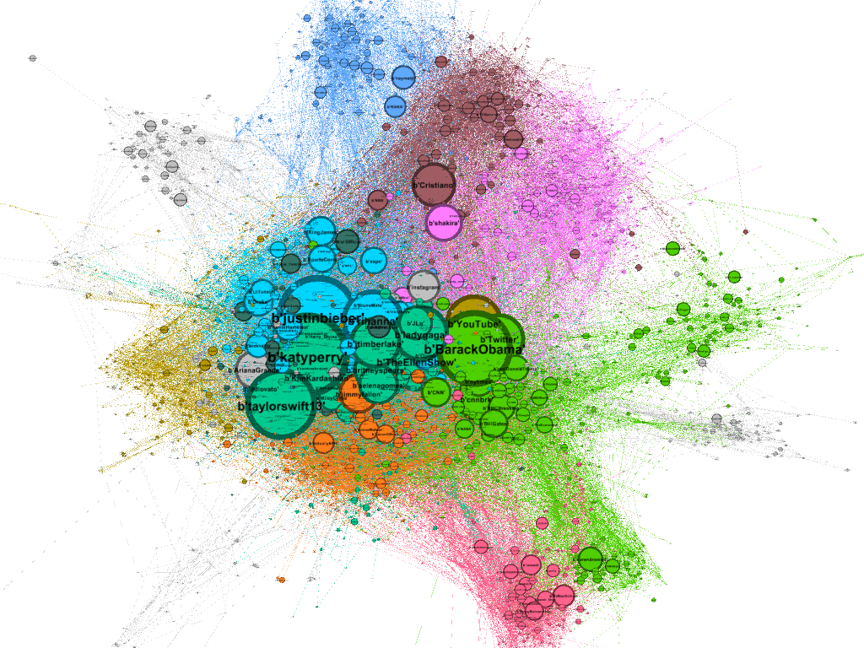
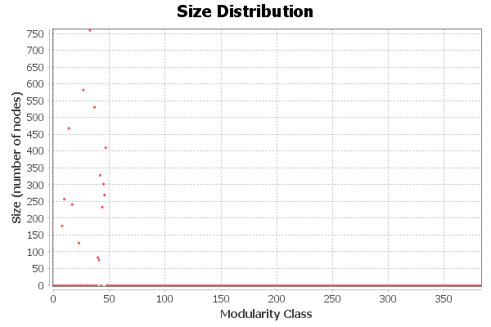
Modularity Community Detection

Slide 4


Real and Fake Sources

Slide 5
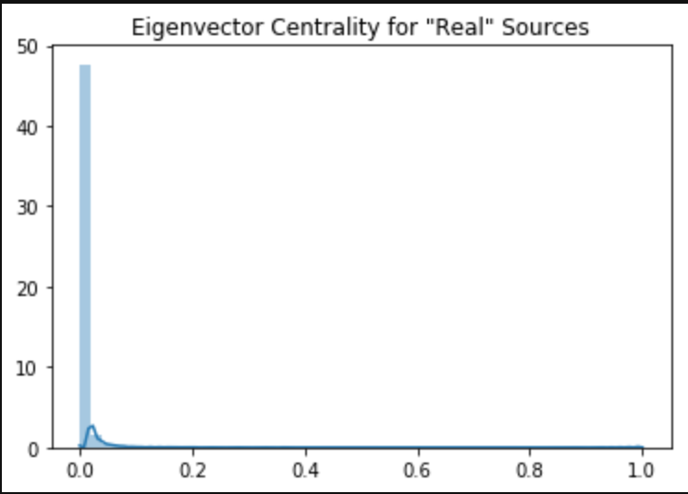
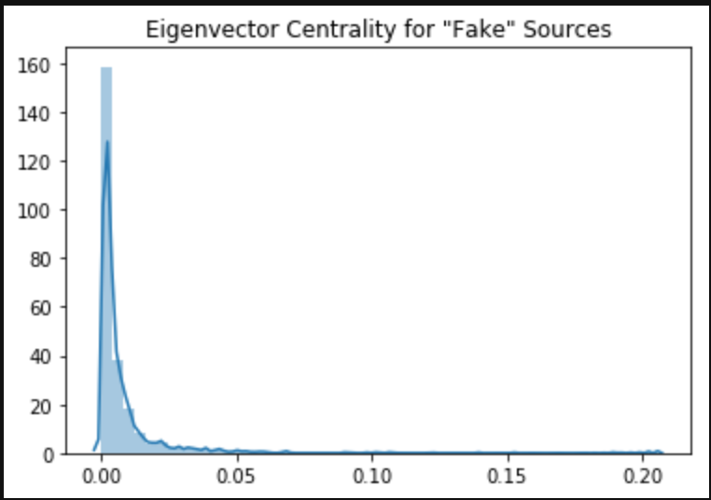
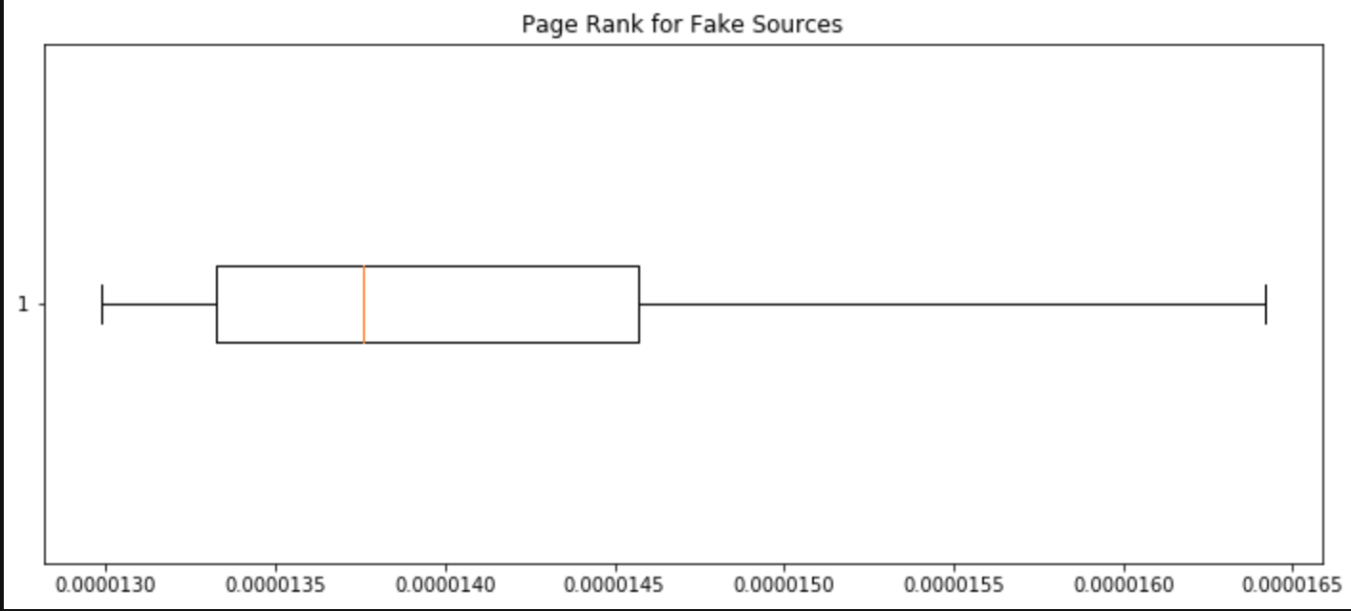
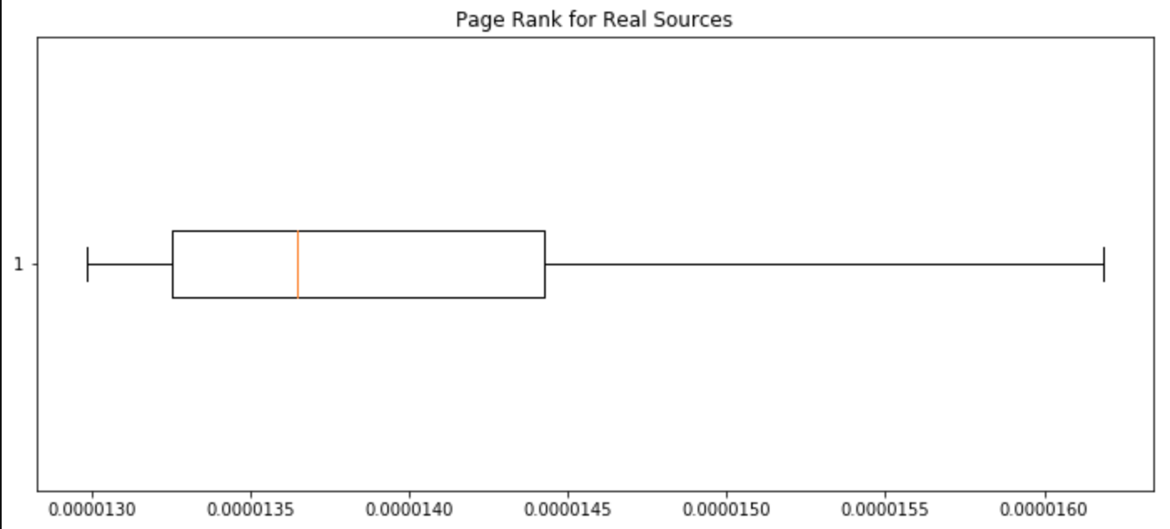
Network EDA

Slide 6
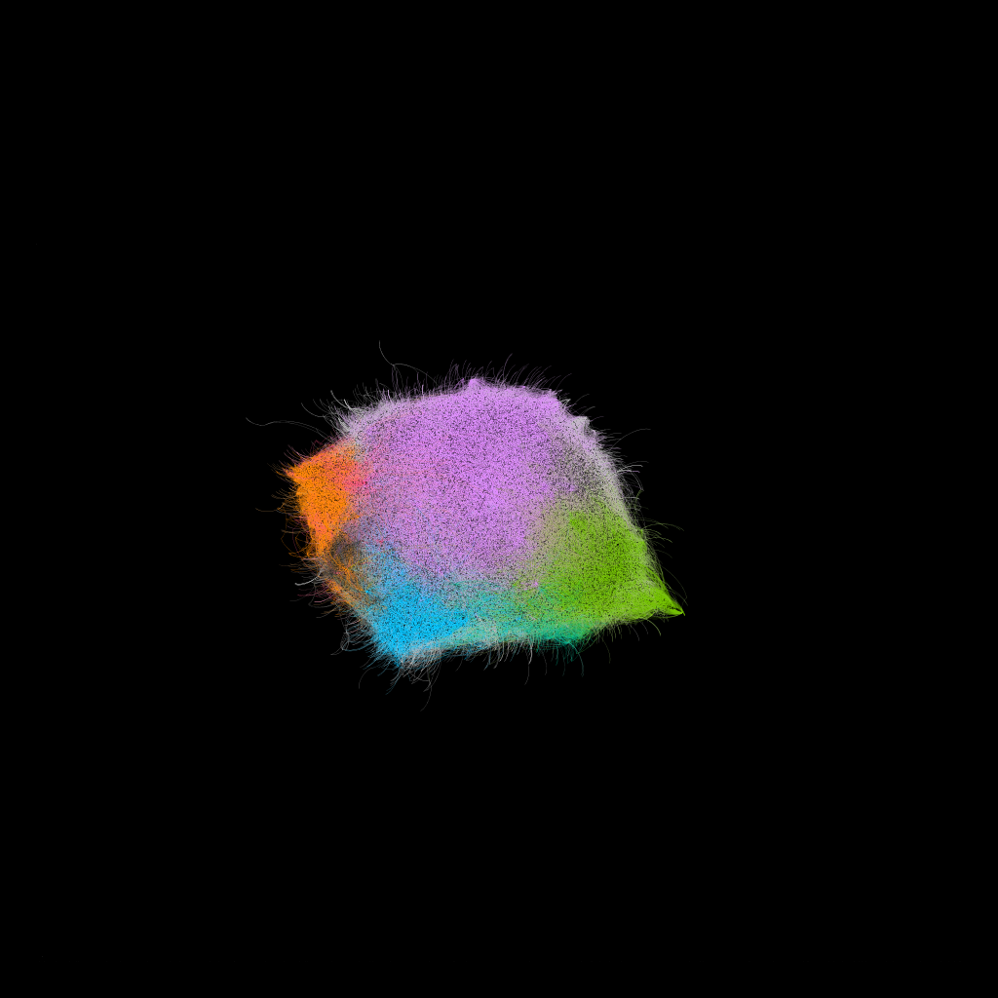
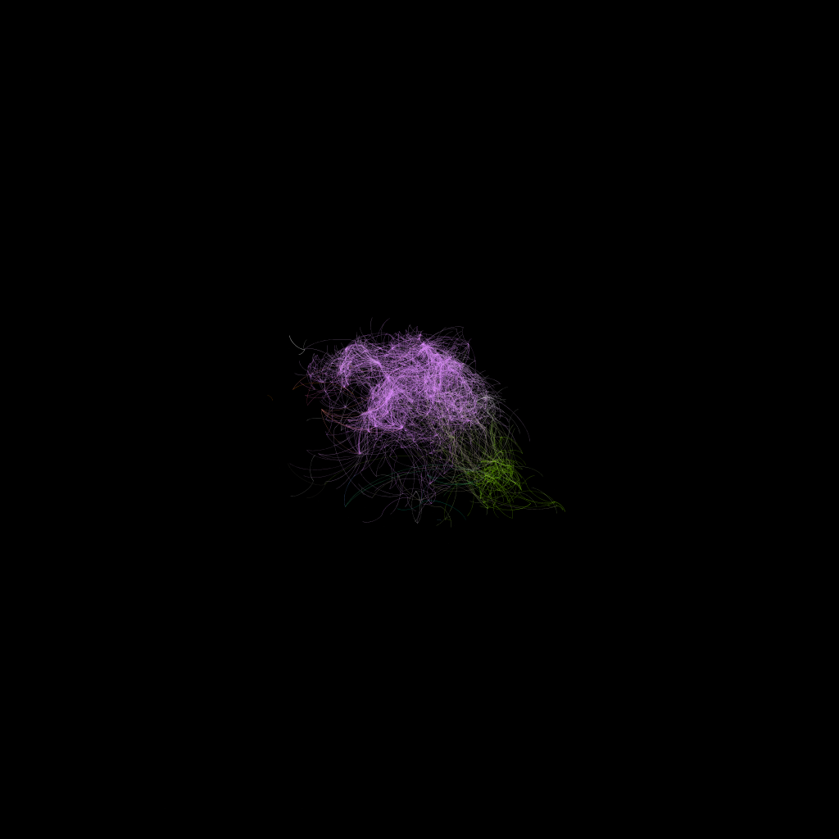
Clustering - Louvain Community Detection

Slide 7
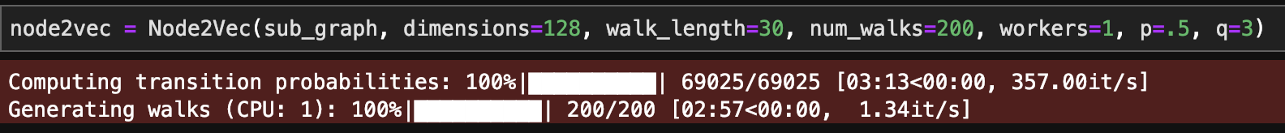
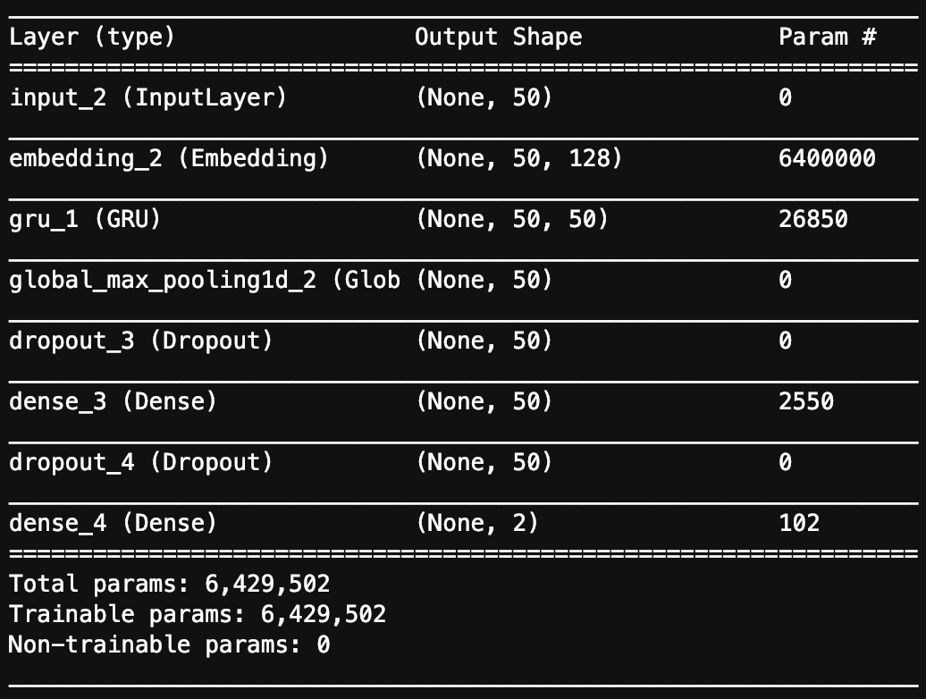
Node2Vec & Word Embeddings

Slide 8
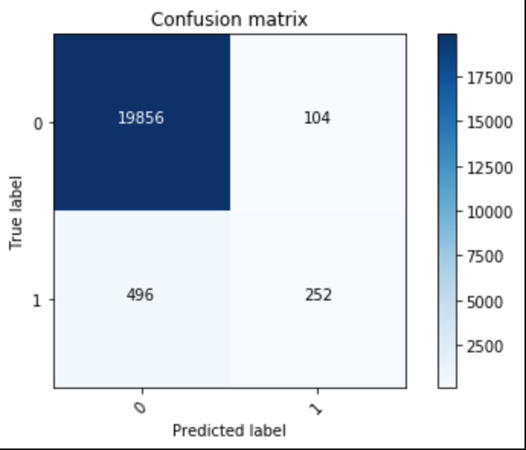
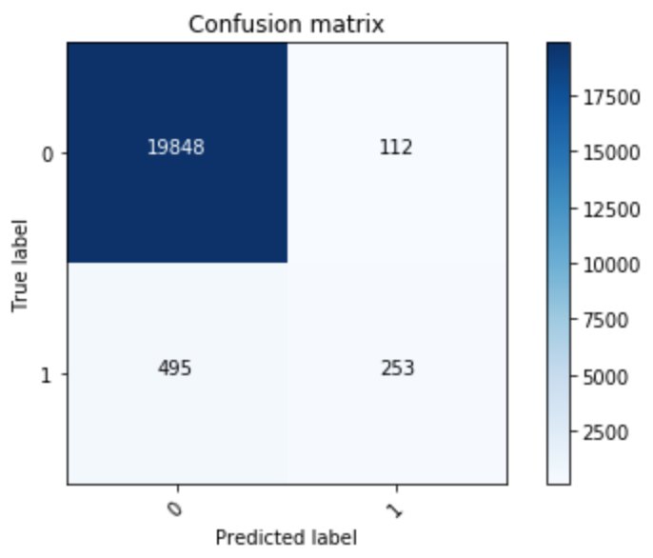
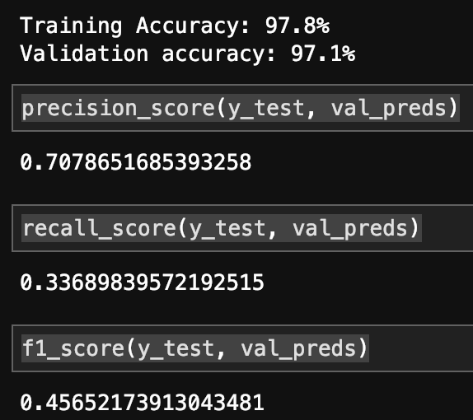
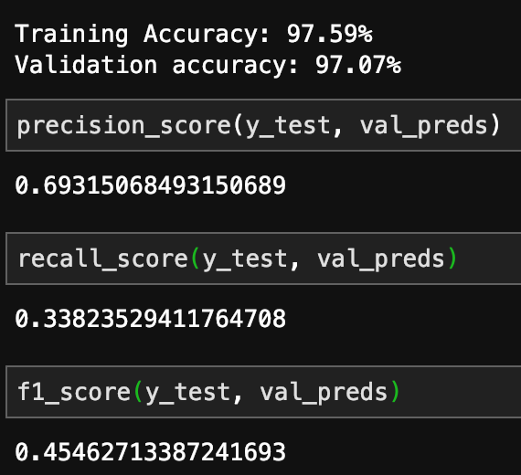
XGBOOST
SUPPORT VECTOR MACHINE

